Slide 1
Microsoft Ignite

Slide 2
Shapeshifter: A Power App and PCF Showcase
Brendon Colburn, MTC Architect
James Stento, MTC Architect

Slide 3
Agenda
Intros and a quick overview
Shapeshifter Demo
Recap of showcased functionalities
Q&A

Slide 4


Today’s Speakers
Brendon Colburn
DC MTC Architect
James Stento
Philly MTC Architect

Slide 5




Chicago
Amsterdam
Oslo
Minneapolis
Stockholm
Detroit
Copenhagen
Calgary
Toronto
Warsaw
Seattle
Montreal
Dublin
Boston
Brussels
Seoul
Microsoft Technology Centers
The hub for innovation on the Microsoft Cloud
Paris
Munich
Beijing
Silicon Valley
New York
Tel Aviv
Shanghai
Tokyo
Philadelphia
Milan
Dubai
Irvine
Washington DC
Istanbul
Bengaluru
Taipei
Denver
Mexico City
Atlanta
Mumbai
Singapore
Dallas
Houston
Sao Paulo
Sydney
St. Louis
Johannesburg
Canberra

Slide 6

The Story of ShapeShifter

Slide 7
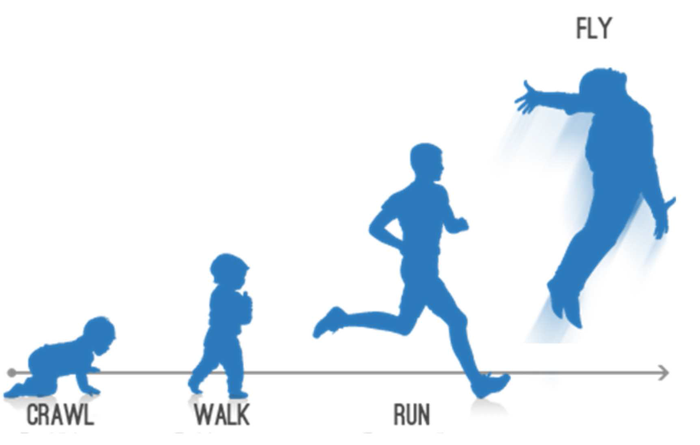
The Concepts
PowerApps Component Framework (PCF)
Command Line Interfaces
PowerFX (some new stuff)
GitHub Codespaces
Containers / Docker
GitHub Co-pilot
Dynamically rendering controls
ReactJS
TypeScript

Slide 8
Demo
Brendon Colburn

Slide 9
Recap
Advanced PowerFX
ShapeShifter Embedded
ShapeShifter Defined
ShapeShifter Changed
Index()
$”{String Formatting}”
JSON()
Concurrent()
Single-embed
Multi-embed within a gallery
Label, ControlType, Options, and Default parameters allow for dynamic rendering
VSCode, in a docker container via GitHub Codespaces!
React Fluent UI controls in a Switch on ControlType
TypeScript for more controlled development (IShapeShifterProps interface)
Event Handlers in index.ts
ControlManifest.xml does the rest
React “Hot Reload” Test Harness
GitHub Copilot for adding new controls fast!
Power Apps CLI to deploy our updated ShapeShifter to Dataverse
Updating the Canvas App we can now use the new control

Slide 10
Q & A

Slide 11
Helpful Links
https://github.com/Brendon-Colburn/shapeshifter - Shapeshifter Repo
GitHub Codespaces – Get started with Codespaces
GitHub Copilot · Your AI pair programmer – Get started with Copilot
Power Fx | Microsoft Power Apps – Blog – Keep up with Power FX updates
Adding TypeScript | Create React App (create-react-app.dev) – Get started with React + TypeScript
Microsoft Power Platform CLI - Power Platform | Microsoft Learn – Power Platform CLI
What are code components? - Power Apps | Microsoft Learn – Code Components Overview
Fluent UI - Controls - React (microsoft.com) – Reference for Fluent UI React Controls
React (virtual) and Fluent UI code components – Reference for Virtual Controls
rajyraman/pcf-dev-container (github.com) – Template repo for containerized PCF controls.. Be sure to up-version the .NET Core version in the dockerfile

Slide 12
Closing

